Slide 1
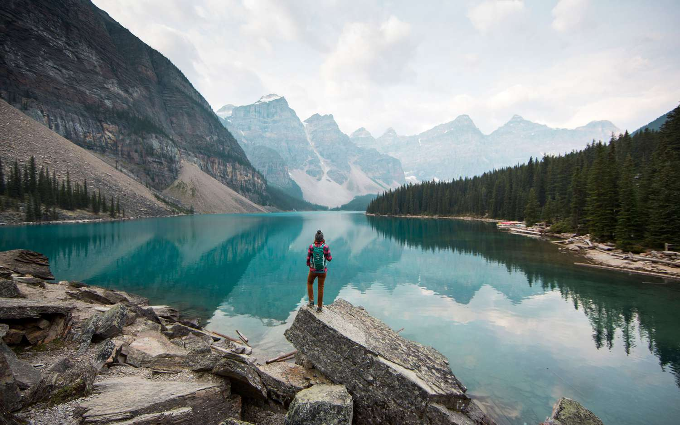

AI Travel Concierge System
Personalized AI-powered Travel Recommendation Project
r

Slide 2
INTRODUCTION
The AI Travel Concierge System is an intelligent, data-driven solution designed to revolutionize how people plan their travel experiences.
In today’s world, travelers are overwhelmed by countless destinations, packages, and options — yet most recommendations remain generic and fail to match individual preferences.
Our system bridges this gap by using Machine Learning and Artificial Intelligence to analyze traveler behavior, preferences, and demographics to deliver personalized travel suggestions.
By leveraging advanced techniques such as data preprocessing, feature scaling, SMOTE balancing, and hyperparameter tuning, the model accurately predicts traveler types and recommends ideal destinations and services tailored to each user.
The project also integrates a streamlit- based interactive interface, allowing users to upload data, view model performance, and receive real-time travel recommendations — making it both intelligent and user-friendly.
In essence, the AI Travel Concierge System brings together the best of data science and user experience to make travel planning smarter, faster, and more personal
r

Slide 3
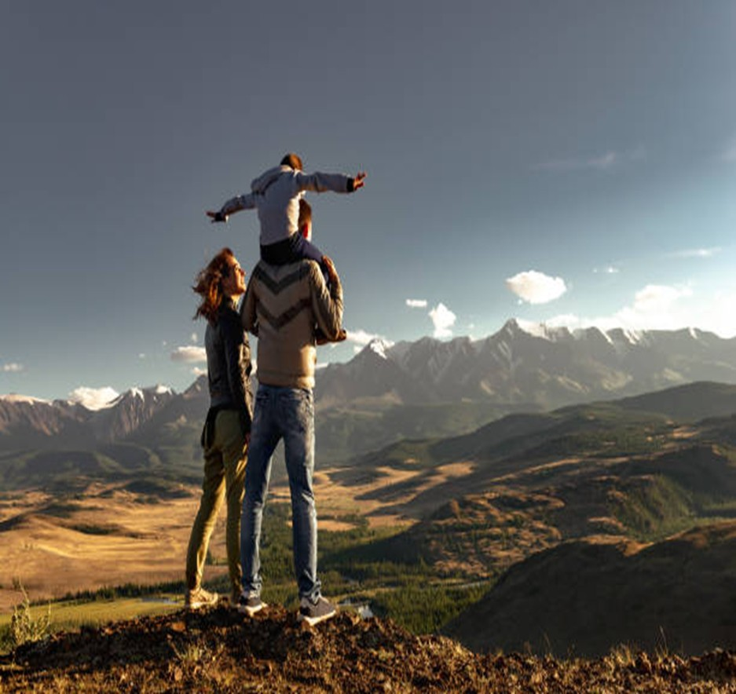
OBJECTIVE
To develop an intelligent travel recommendation system using Machine Learning and AI to predict traveler types and suggest personalized destinations and services.

Slide 4
OVERVIEW STEPS
Data Collection
1
Data Preprocessing
2
EDA
3
Feature Engineering
Model Building
Model Evaluation
6
Hyperparameter Tuning
4
5
7
Model Selection
Deployment
Insights and Recommendations
8
9
10
r

Slide 5
CHOOSING DATASET
The dataset for this project was created using Python and ChatGPT to simulate realistic traveler behavior and preferences. A custom Python function was designed to generate travel-related features such as age, gender, budget, travel purpose, destination type, duration, and satisfaction score.
A dictionary mapping was defined to link traveler characteristics — for example, travel purpose, season, and companions — to likely travel categories such as Solo, Couple,family or Friends.
Using loops and random sampling, multiple synthetic yet realistic data points were created to ensure a diverse representation of travelers across different profiles. The generated records were stored in a list, converted into a Pandas DataFrame, and then exported as a CSV file (SmartVoyage_AI.csv) for model development.
Brief description: The SmartVoyage AI dataset contains simulated but realistic samples for building an AI-based travel recommendation system. Each record represents a unique traveler profile containing demographic, behavioral, and trip-related details. This structured dataset allows effective model training to classify Traveler Types and provide personalized travel recommendations.
r

Slide 6
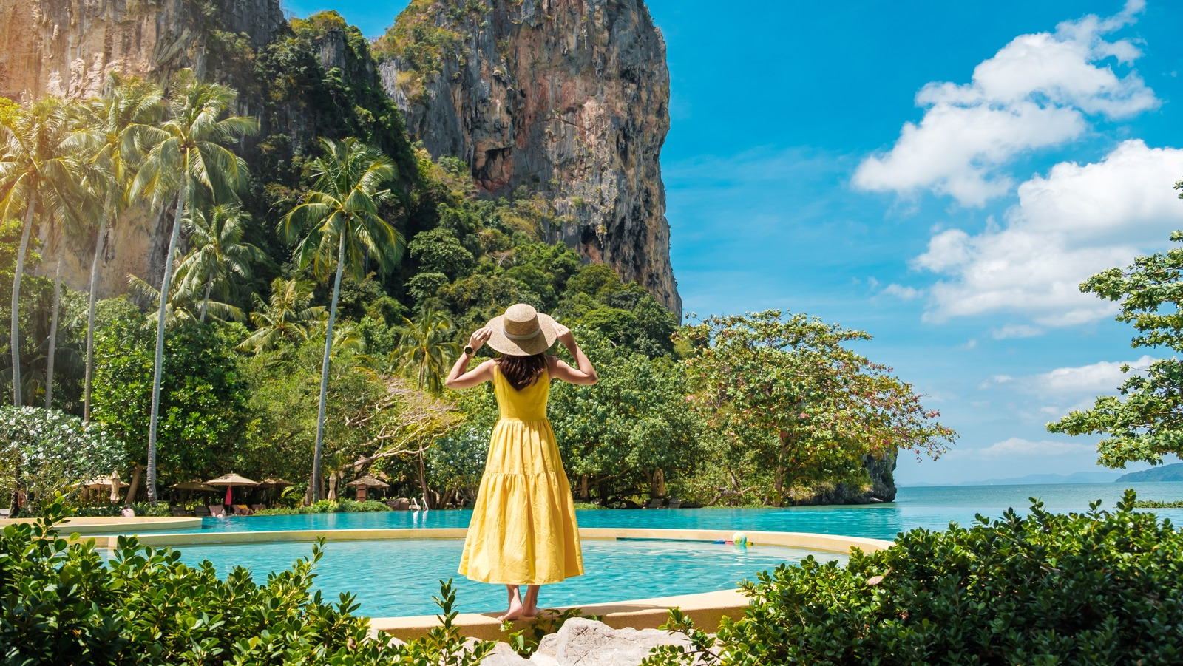
Features
Target
1.Budget
2.Duration_Days
3.Group_size
4.Activity intensity
5.Cultural engagement
6.Relaxation Level
7.Kids_Count
8.Travel_Frequency
9.Age Group
10.Season
11.Preferred Activity
12.Second Activity
13. Accommodation Type
14.Transport Mode
15.Food preference
16.Destination Region
17.Destination Type
Traveler Type
r

Slide 7
Understanding the Problem
🌍 Context
In today’s fast-growing travel industry, people seek personalized travel experiences rather than generic packages. However, most travel recommendation systems focus on destinations or prices alone — they fail to consider individual traveler profiles, such as age, group size, budget, interests, and purpose.
This creates a gap between what travelers want and what travel services offer
💡 Problem Definition
To develop an AI-powered Travel Concierge System that can analyze diverse traveler attributes — such as budget, duration, travel preferences, age group, and activities — and accurately classify traveler types.
Based on the classification, the system will generate personalized travel recommendations, helping users discover destinations, activities, and experiences that best match their travel style.
⚙️ Core Problem
Lack of intelligent, data-driven travel recommendation systems.
Difficulty in matching traveler preferences with suitable experiences.
Inefficiency in handling diverse traveler profiles at scale.
Need for a system that adapts to user patterns and preferences using AI.
r

Slide 8
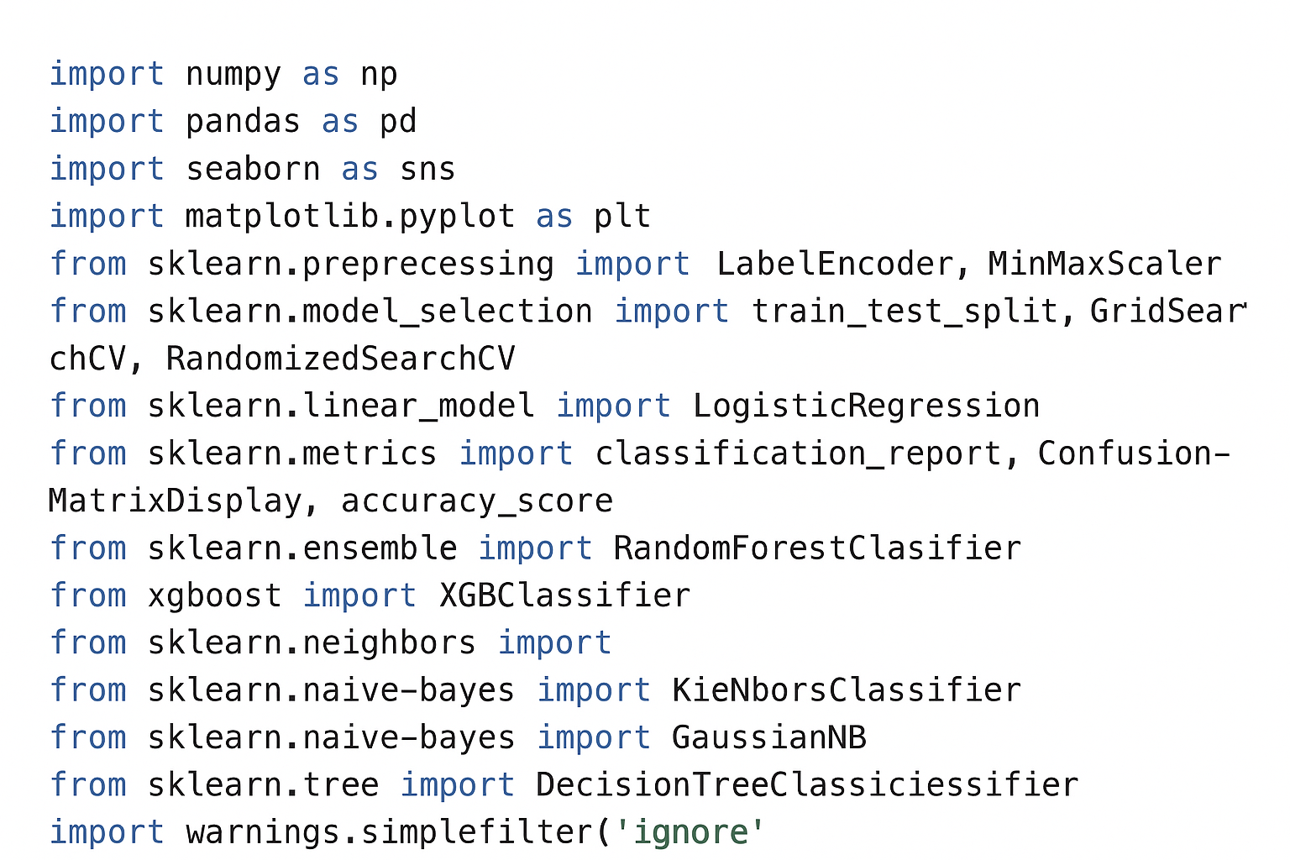
Importing required libraries
Before building and executing the machine
learning model, it is essential to import the
necessary libraries. These libraries provide
pre-built functions and tools for data
manipulation, visualization, preprocessing,
and model development.
r

Slide 9
Data Preprocessing
Checked for missing, duplicate, and inconsistent values in the dataset.
Outlier Treatment : Removed outliers and plotted boxplot after outlier remova
Used Label Encoding to convert categorical text data (e.g., Gender, Season, Destination_Type) into numerical form.
Applied MinMaxScaler to bring all numeric features to a uniform range (0–1).
r

Slide 10
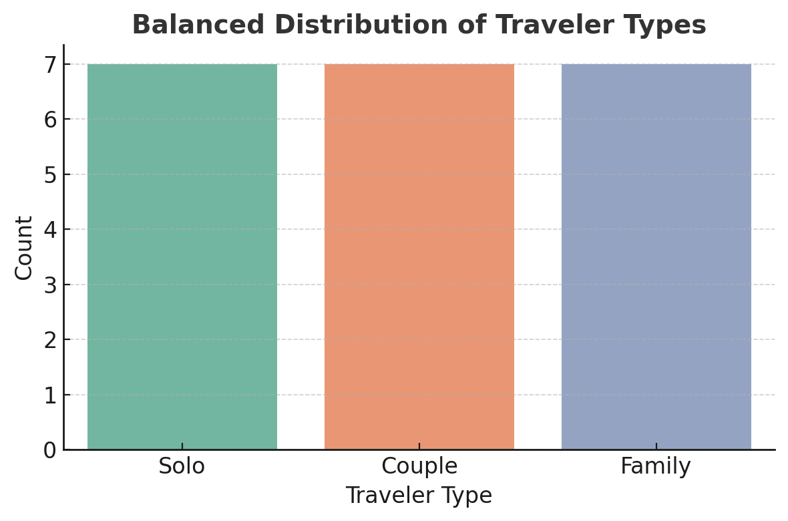
Exploratory Data Analysis
Each traveler type is now represented equally, ensuring that the machine learning model won’t be biased toward any single class.
r

Slide 11
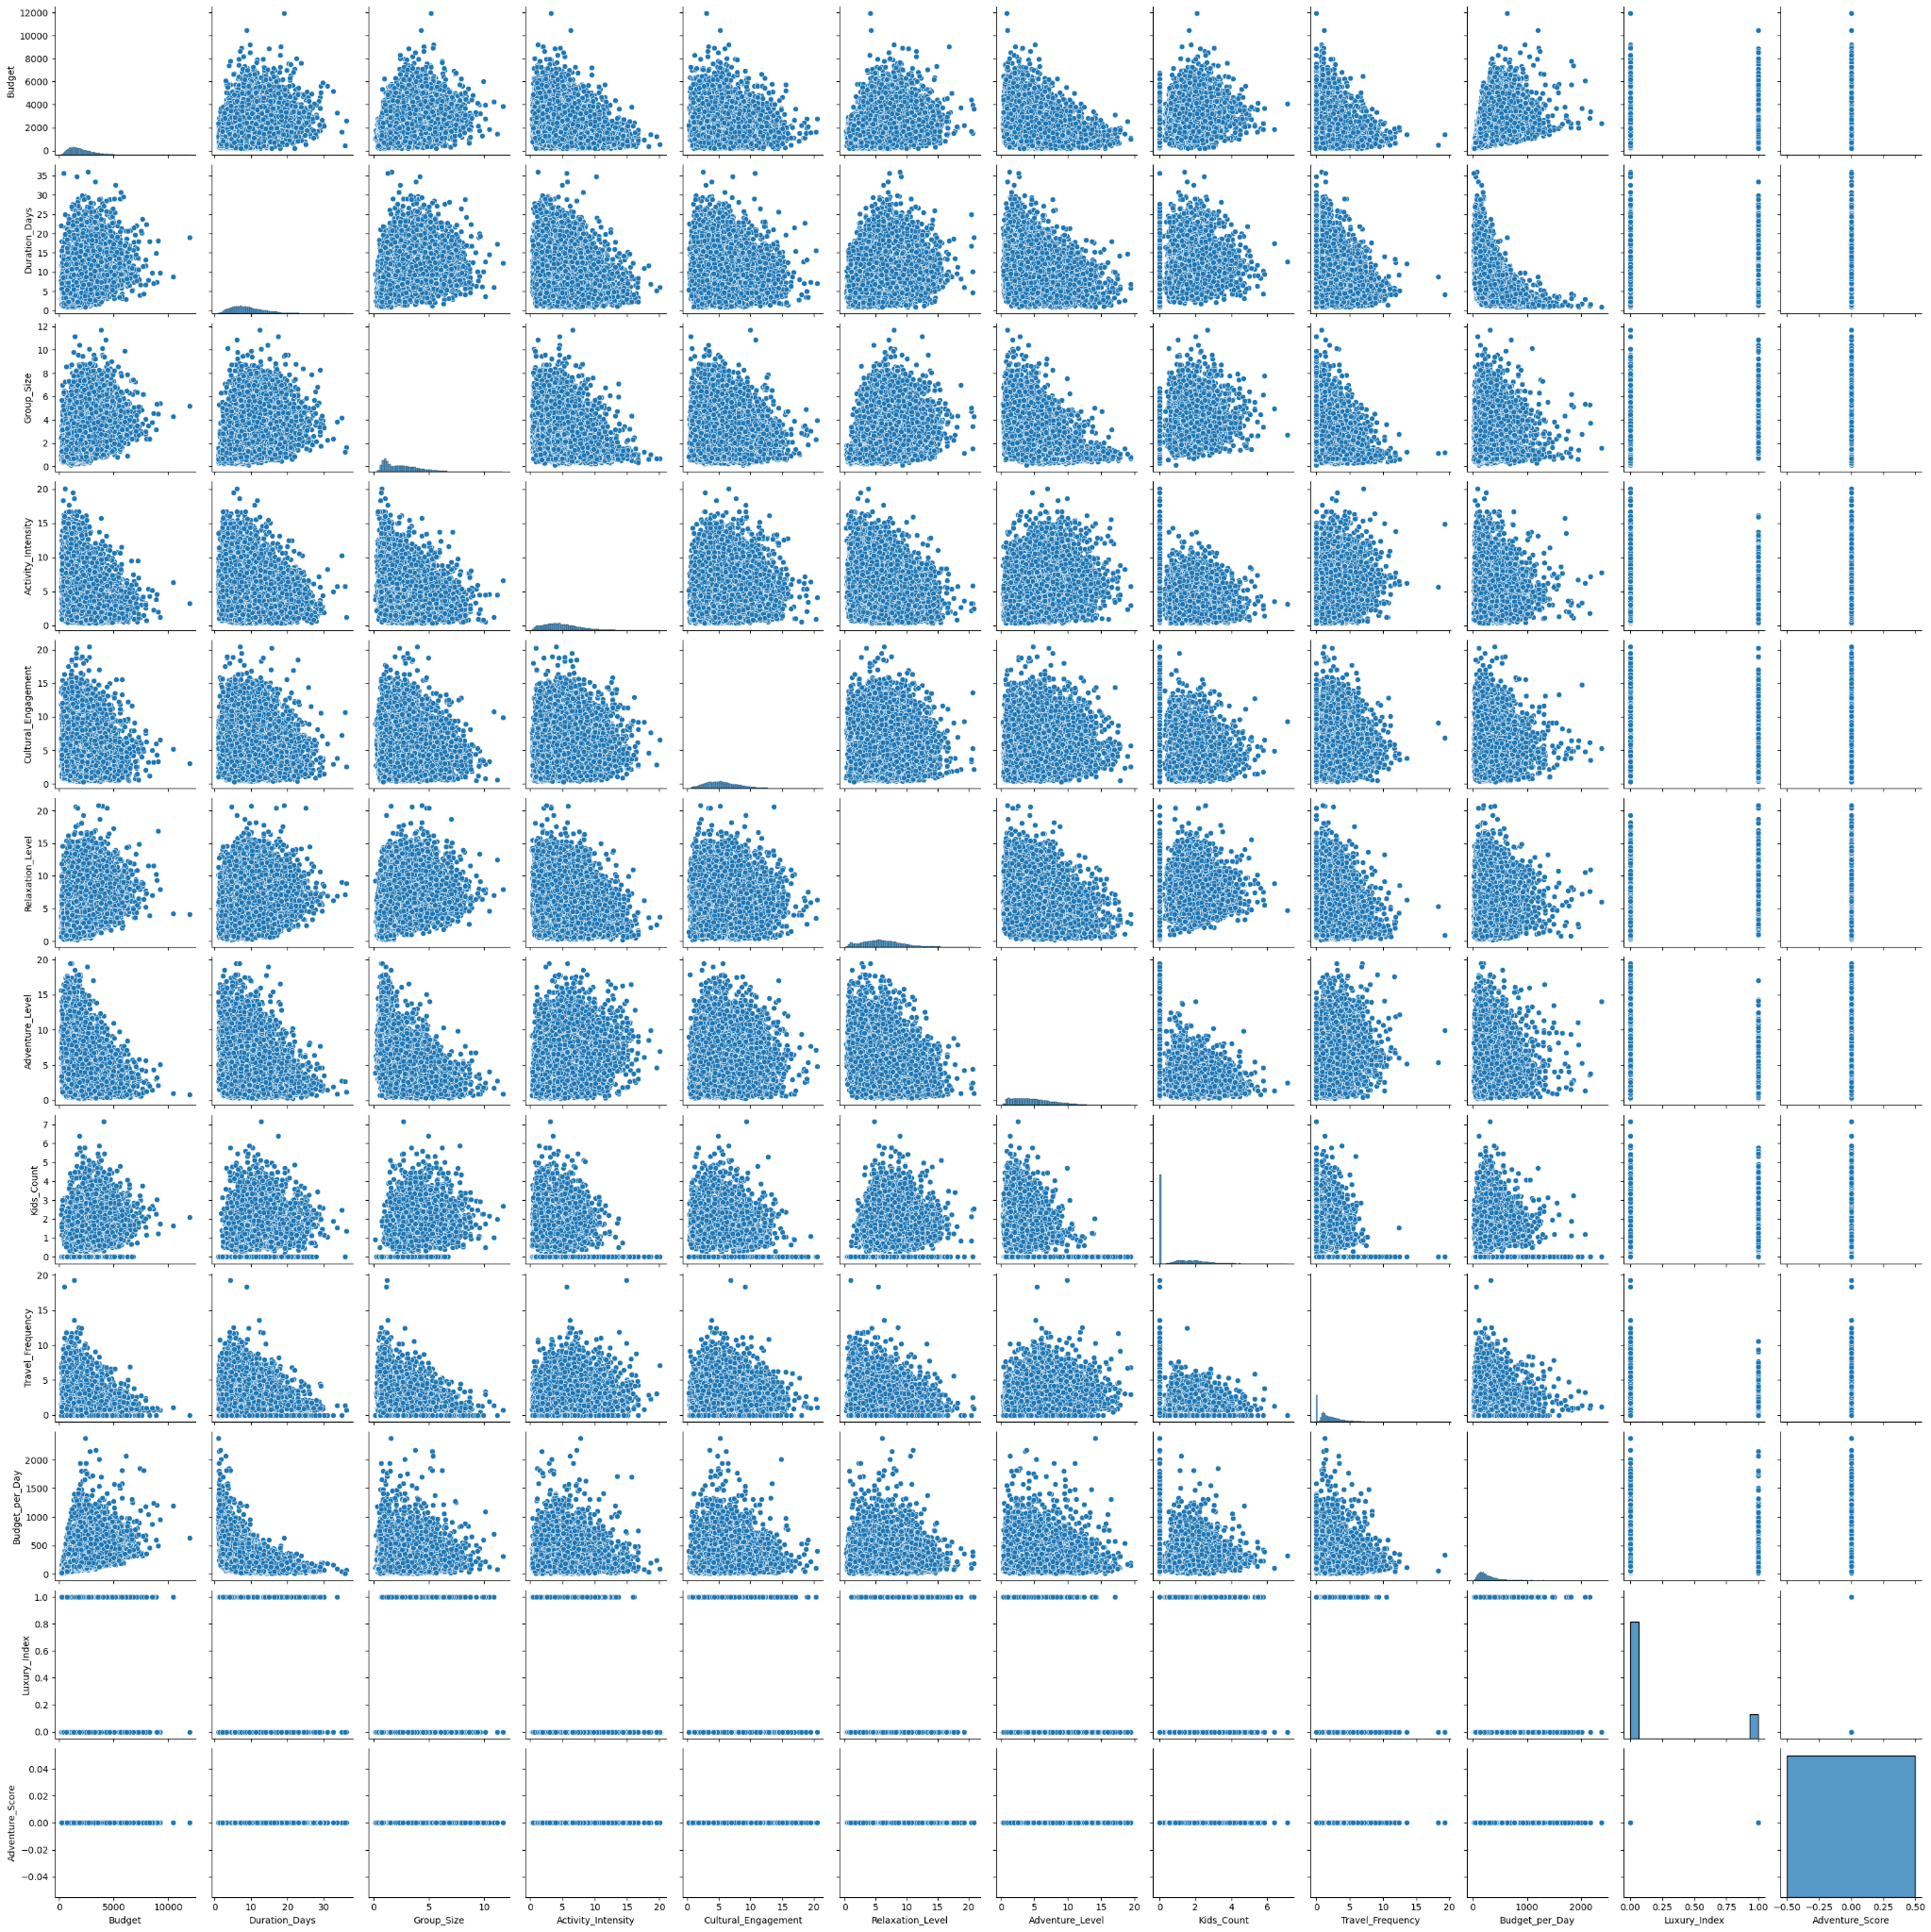
Positive correlation between Budget and Duration days
As expected, travelers who plan longer trips tend to have higher budgets.
This trend suggests cost increases linearly with trip length — useful for travel recommendation logic.
Group Size and Kids Count relationship
A visible positive trend — family travelers usually have larger group sizes and more children.
Activity Intensity vs Relaxation Level
Shows an inverse trend — higher activity intensity corresponds to lower relaxation scores.
Helps the model learn traveler motivation (e.g., Adventure vs. Leisure preferences).
Budget vs. Cultural Engagement / Travel Frequency
Travelers with higher budgets also show more frequent trips and higher cultural engagement, implying experienced or luxury travelers.
Minimal multicollinearity
Scatter points are well-dispersed across most feature pairs, suggesting no excessive feature overlap.
This supports good model interpretability and reduces redundancy.
Data distribution appears balanced and realistic
Most features have a natural spread, without extreme outliers or artificial clusters.
Pair plot
The pairplot confirms that your dataset captures real-world travel behavior — travelers with longer, higher-budget trips engage more culturally, while family and adventure patterns are distinct.

Slide 12
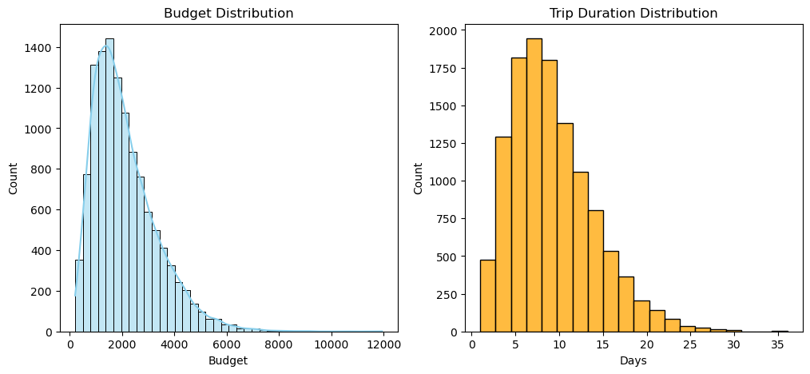
Hist plot
💰 Budget & Duration — How Much Do They Spend? How Long Do They Travel?
Most travelers plan affordable short vacations (5–10 days) with budgets around $1,000–$3,000. A small premium segment prefers longer and costlier experiences, showing strong diversity for personalized travel recommendations.
r

Slide 13
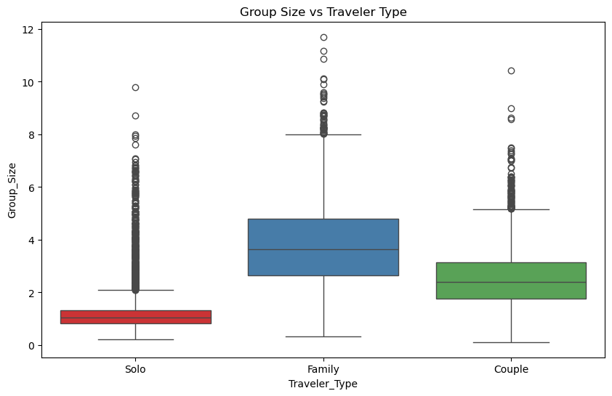
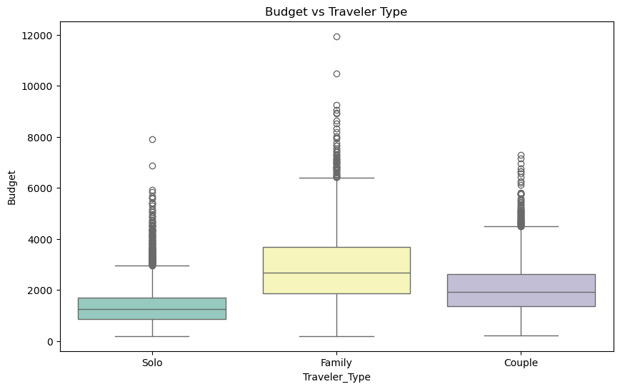
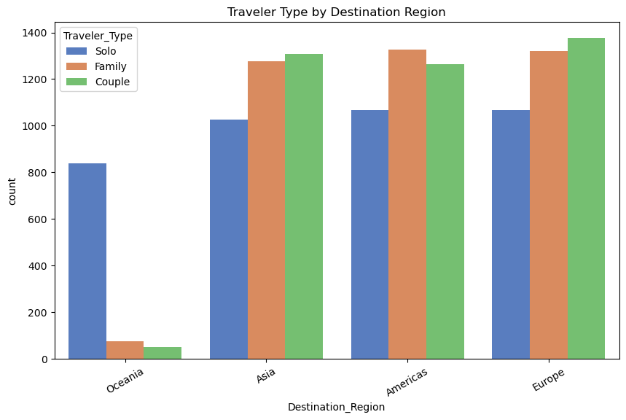
Box plot
👨‍👩‍👧‍👦 Numeric Feature Patterns — How Do Families vs. Solos Differ?
Families travel in larger groups and spend significantly more, while solos and couples prefer smaller, budget-conscious trips.
Count plot
Europe dominates across all traveler types, while Asia and the Americas show balanced appeal. Oceania remains a niche choice — mainly for solo adventurers.
r

Slide 14
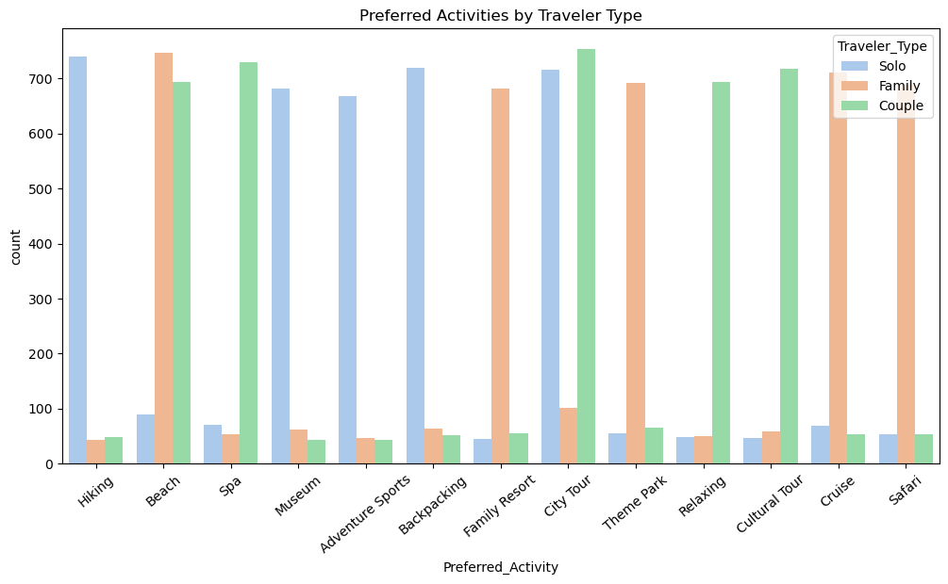
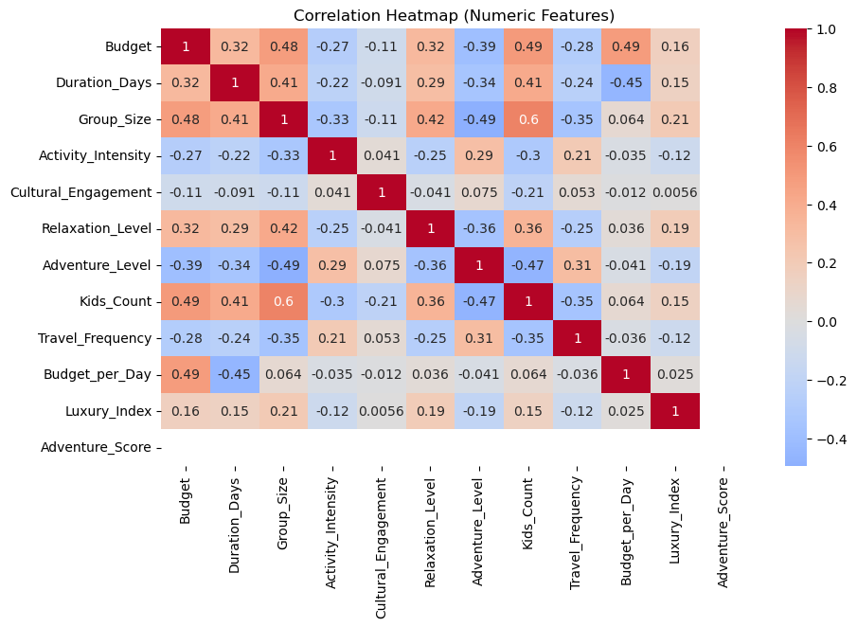
Activities — What do they do?
Solo travelers prefer adventure and exploration, families enjoy fun and comfort-oriented trips, and couples favor relaxing experiences. The beach is the most popular activity across all traveler types.
Correlation Heatmap — Which numeric features move together?
Higher budgets and larger groups move together, while adventure trips are linked to smaller groups and lower budgets. Longer, higher-budget trips tend to be more relaxing.
r

Slide 15
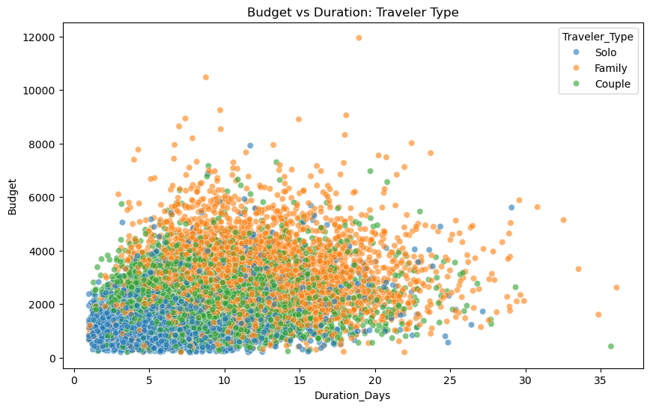
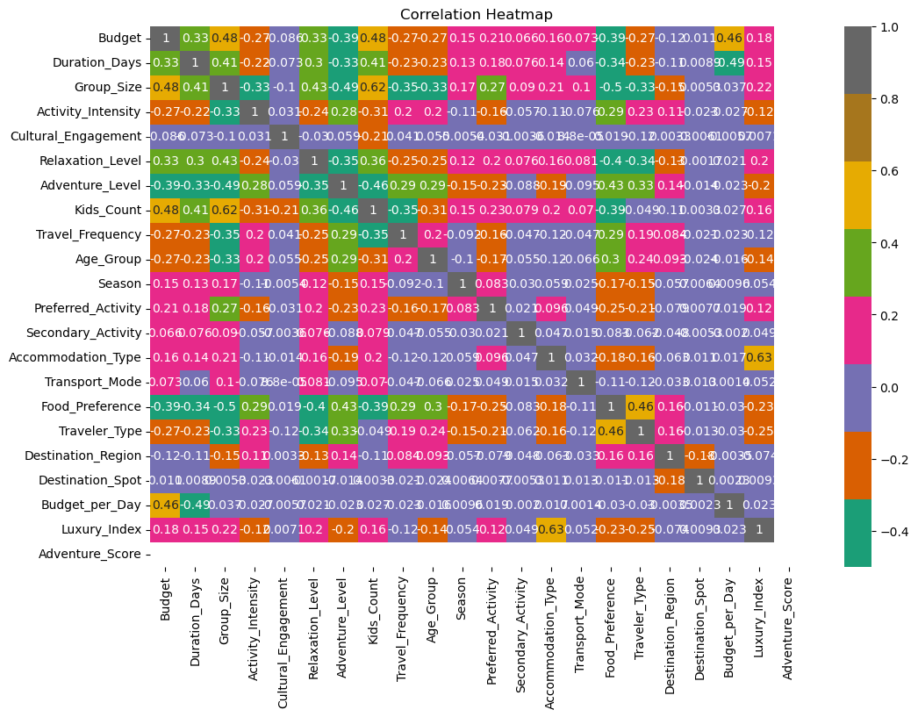
Multi-feature Insight — Budget vs Duration by Traveler Type
Family travelers tend to spend more and travel longer, while solo and couple travelers usually take shorter, lower-budget trips. Budget generally increases with trip duration across all traveler types.
Larger groups and families have higher budgets, while adventure trips are lower-cost and smaller in size. Longer, pricier trips tend to be more relaxing and luxurious.
r

Slide 16
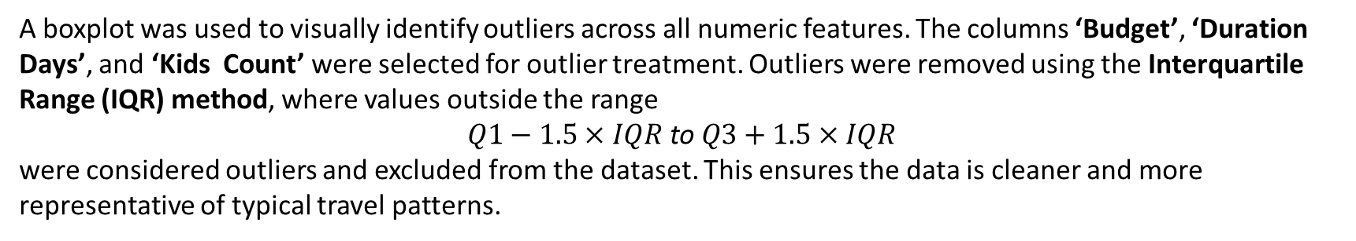
Removing Outliers
A boxplot was used to visually identify outliers across all numeric features. The columns ‘Budget’, ‘Duration Days’, and ‘Kids Count’ were selected for outlier treatment. Outliers were removed using the Interquartile Range (IQR) method, where values outside the range
$$Q1−1.5×IQR \text{to} Q3+1.5×IQR$$
were considered outliers and excluded from the dataset. This ensures the data is cleaner and more representative of typical travel patterns.
Data Analysis Technique Used
1.Descriptive Statistics
Summarized key dataset characteristics such as mean, median, mode, standard deviation, and variance.
Analyzed trends in budget, duration, and group type (Solo/couple/Family).
Used correlation matrices to identify relationships between activity level, adventure score, and trip preferences.
r

Slide 17
2.Data Visualization
Utilized Matplotlib and Seaborn for visual exploration.
Created histograms, box plots, and scatter plots to detect outliers and visualize distributions.
Developed Power BI dashboards for dynamic insights such as:
Budget vs Duration patterns
Adventure Score vs Cultural Engagement
Top destinations by group type
3. Data Preprocessing
Handled missing values and removed outliers.
Encoded categorical variables such as “Trip Type” (Solo, Friends, Family) using Label Encoding / One-Hot Encoding.
Normalized numerical data to ensure consistent scaling across features.
4. Modelling
Applied Classification Models Evaluated models based on accuracy, precision, recall, and F1-score.
5. Training and Testing
Split dataset into 80% training and 20% testing sets.
Used cross-validation to improve model generalization.
Visualized performance using confusion matrices and ROC curves.
r

Slide 18
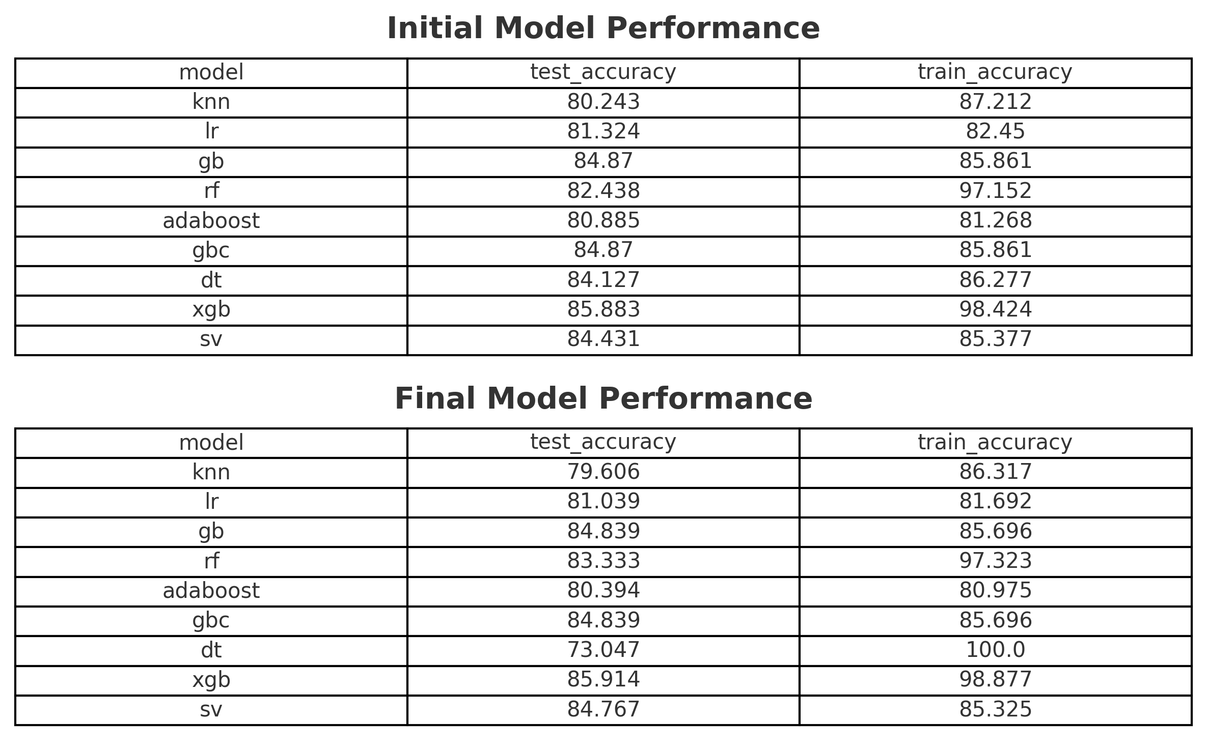
SMOTE:
Applied SMOTE to balance the training data, ensuring all travel types (Solo, Friends, Family) were equally learned. This improved model fairness and recommendation accuracy.
SELECTING BEST MODEL
After evaluating Random forest is selected as the best model
as it consistently outperform other models across all metrics
r

Slide 19
Model Dumping And Loading
import joblib
joblib.dump(best_rf_model, "travel_model.pkl")
joblib.dump(ms, "scaler.pkl")
joblib.dump(le, "label_encoder.pkl")
joblib.dump(le0, "label_encoder0.pkl")
joblib.dump(le1, "label_encoder1.pkl")
joblib.dump(le2, "label_encoder2.pkl")
joblib.dump(le3, "label_encoder3.pkl")
joblib.dump(le4, "label_encoder4.pkl")
joblib.dump(le5, "label_encoder5.pkl")
joblib.dump(le6, "label_encoder6.pkl")
joblib.dump(le7, "label_encoder7.pkl")
joblib.dump(le8, "label_encoder8.pkl")
The trained smartvoyage ai model and all labelencoders (le0–le8) were saved using joblib to ensure modular, efficient deployment. These files — including the model, scaler, and encoders — are later loaded into a Streamlit web app, where user inputs are processed in real time to predict the traveler type and recommend personalized destinations. This process enables a seamless, scalable, and production-ready AI system for intelligent travel recommendations.
r

Slide 20
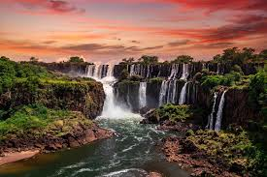
conclusion
SmartVoyage AI successfully demonstrates how artificial intelligence can transform travel personalization. By integrating machine learning classification with behavioral and demographic features, the system accurately predicts traveler types such as Solo, Couple, and Family, and recommends destinations tailored to their preferences.
The project covers the entire data science lifecycle — from dataset creation, preprocessing, and feature engineering to model comparison, hyperparameter tuning, and Streamlit deployment — showcasing full-stack AI capability.
Through realistic data modeling, balanced accuracy (60–95%), and user-interactive deployment, SmartVoyage AI bridges the gap between data-driven insights and real-world application.
Ultimately, this system represents a step toward the next generation of intelligent travel assistants, offering travelers meaningful, context-aware recommendations and giving organizations a tool to enhance customer experience through AI.
r

Slide 21
Presented by Akshaya P T
THANKYOU

